Slide 1


Evaluating the impact of various factors on forest loss in Amapa, Para, and Mato Grasso
between 2000 and 2020
Chengming Zhou, Jason Zheng, Mina Wei, Jessie Xu

Slide 2
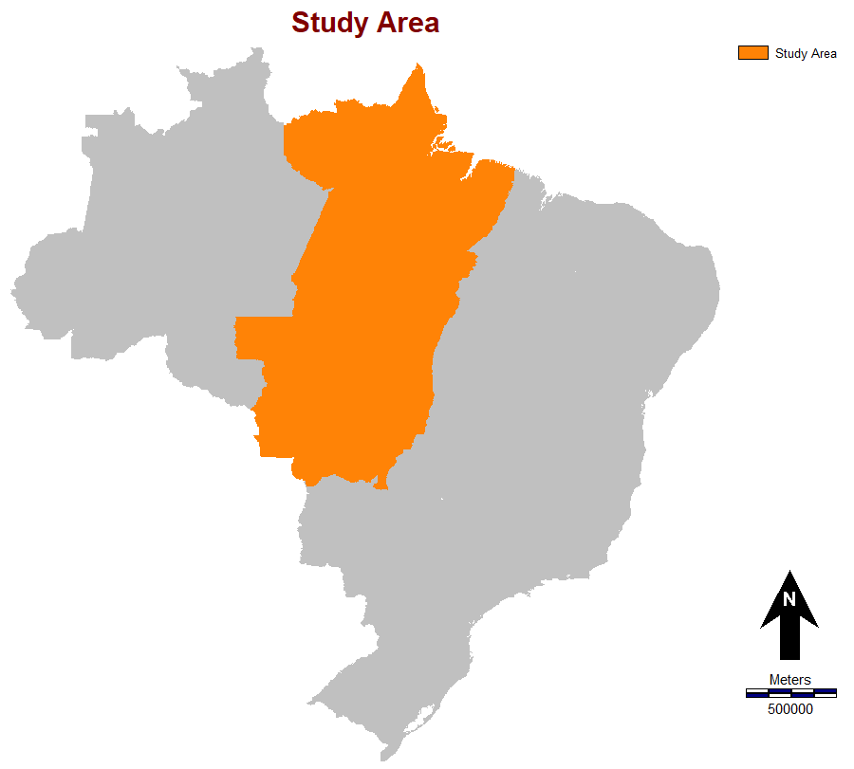
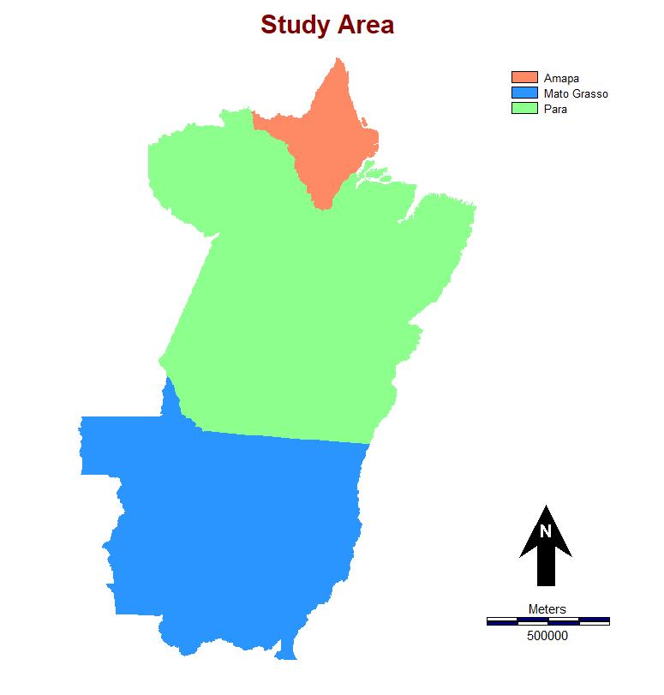
Study Area
Research Questions
Do more drivers produce more accurate simulations?
Which drivers produce the most accurate simulations?
What is the effect of stratification on the simulations?
Brazil
Amapa
State Name | Forest Loss
Mato Grasso | 3.3%
Para | 3.3%
Amapa | 0.5%
Para
 |  | Reference Forest
 |  | Loss | Stable
Simulation Forest | Loss | Hit | False Alarm
 | Stable | Miss | Correct Rection
Mato Grasso

Slide 3
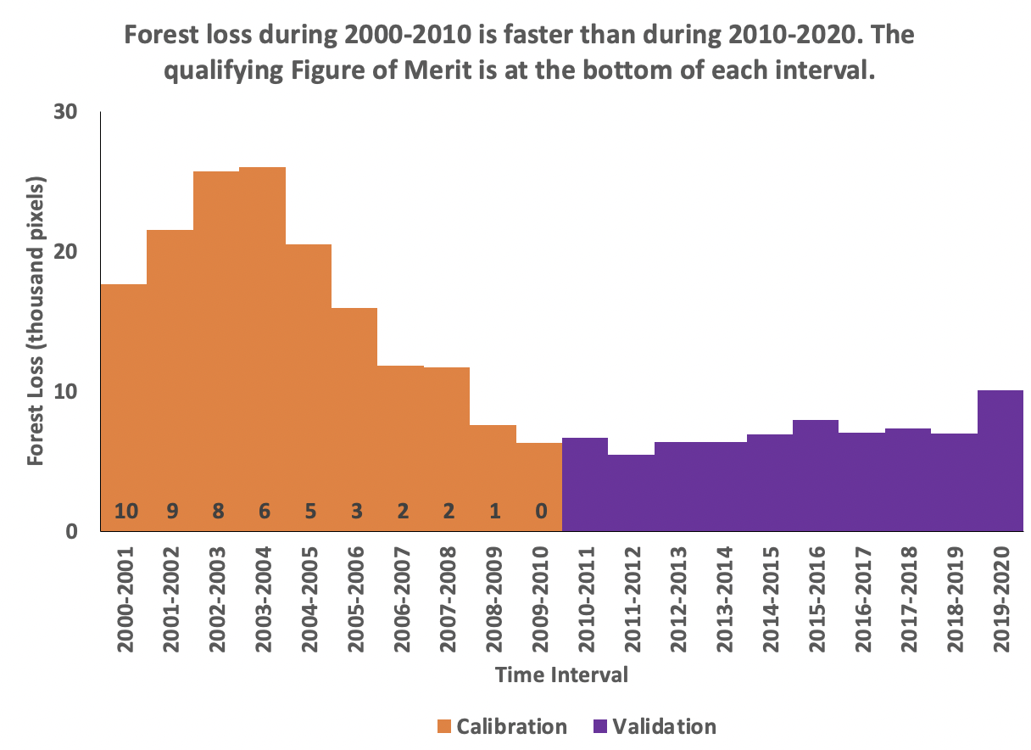
Time Interval

Slide 4
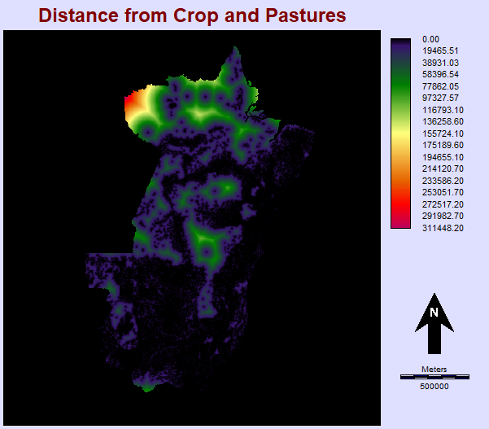
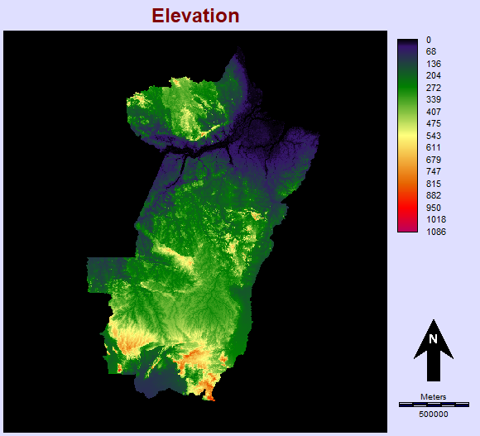
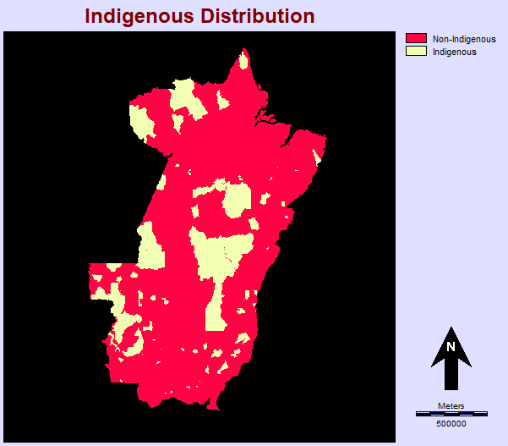
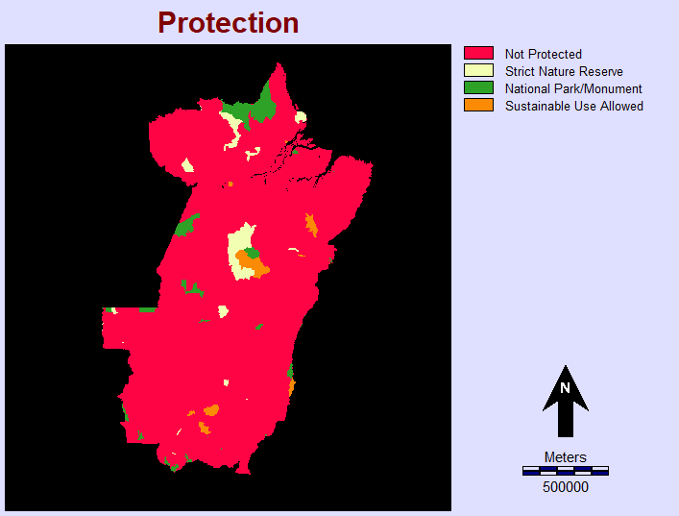
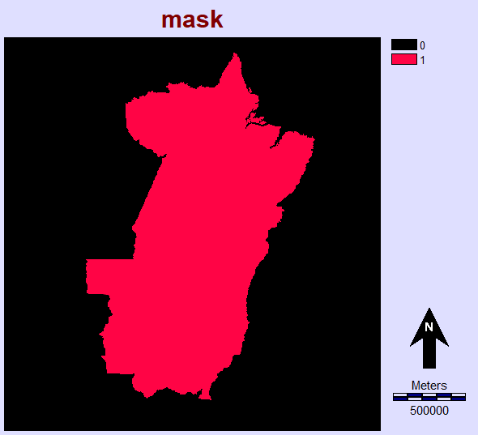
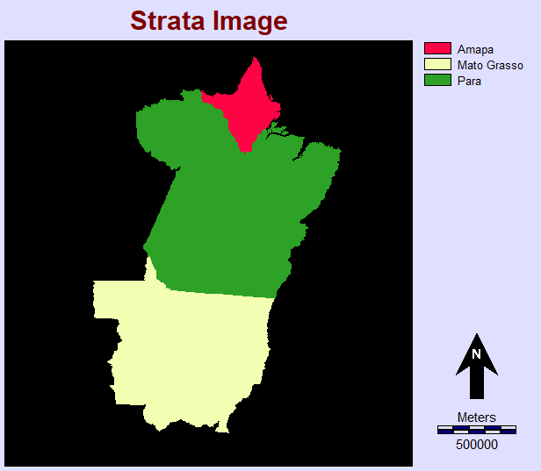
Methodology
Drivers:
Elevation, Distance from Crop and Pastures,
Indegenous distribution, Protection area
In GeoMod:
Use 2010 masked Forest map as starting image
Set Neighborhood search mod to unconstrained
Perform 4 runs:
Run 0: Individual Driver for 4 sub-runs
Run 1: Elevation and Distance from Crop and Pastures
Run 2: Protection and Indigenous Distribution
Run 3: All the 4 driver maps above
2 sub-runs in run 1 - run 3: One uses the state map as the strata image, and the other one does not
Calculate FOM and run TOC Curve

Slide 5
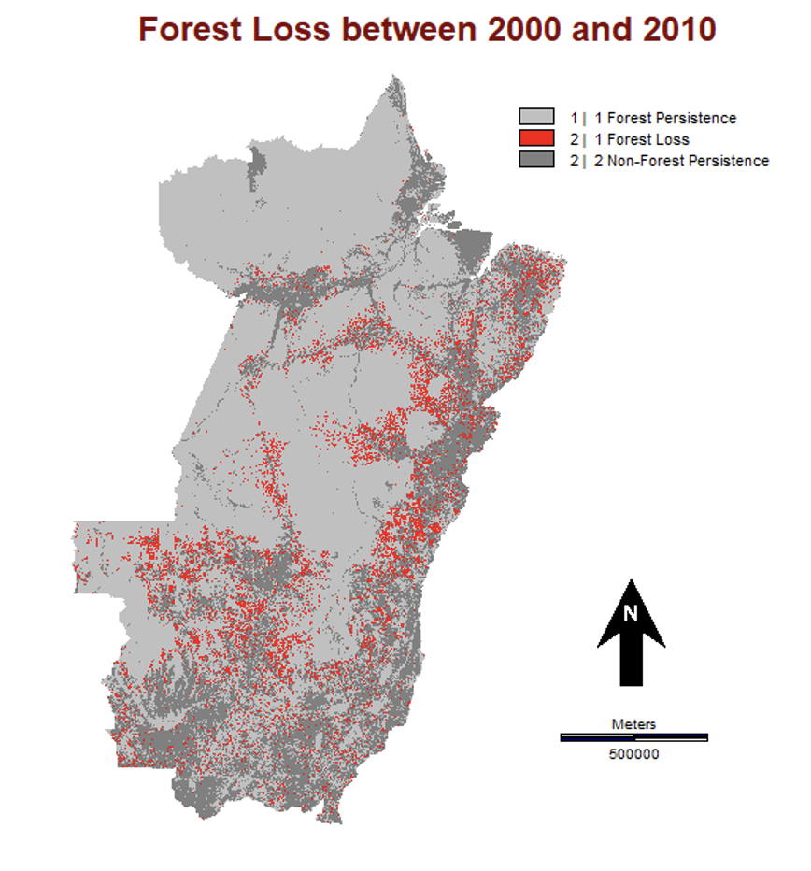
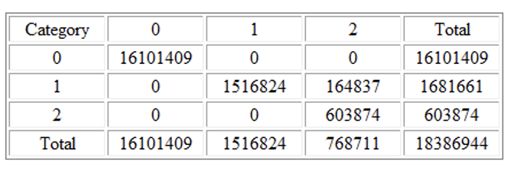
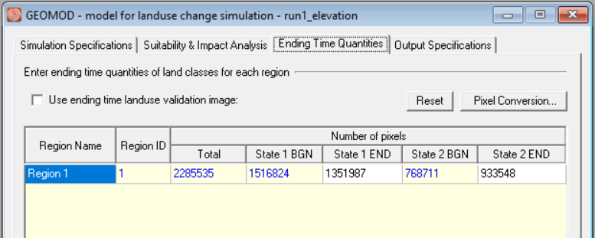
Calibration without strata image
State 1 END representing forest in 2020
= 1,516,824 - 164,837 = 1,351,987
Proportion change during calibration interval
= 164837/1681661= 9.80%

Slide 6
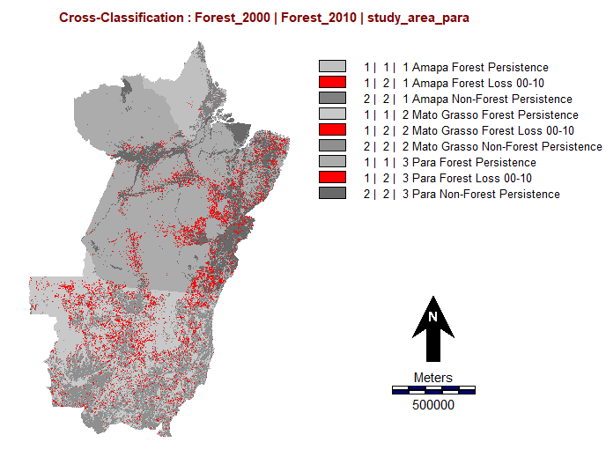
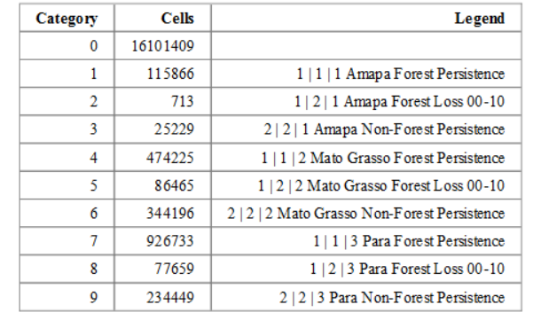
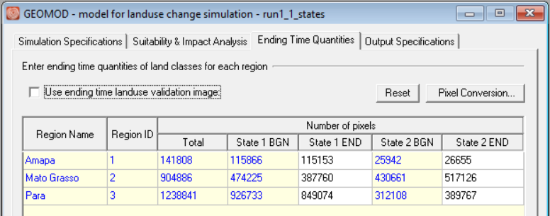
Calibration with strata image

Slide 7
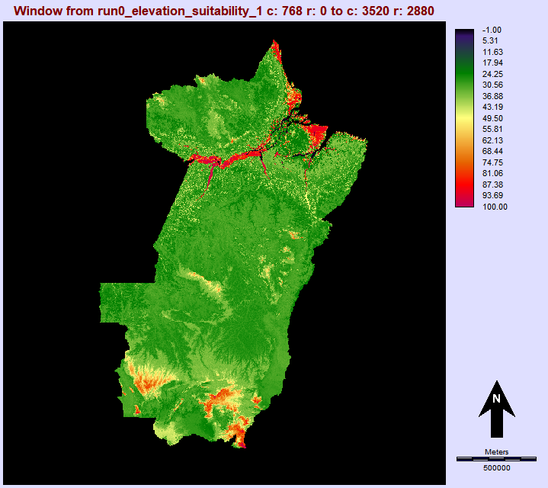
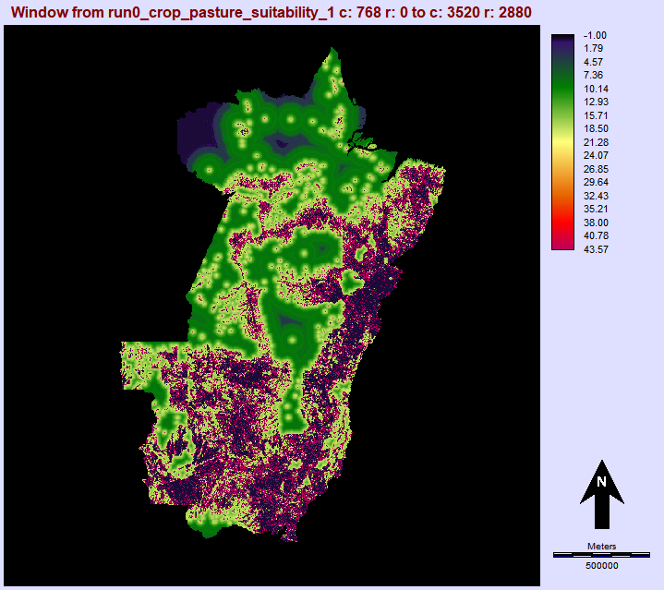
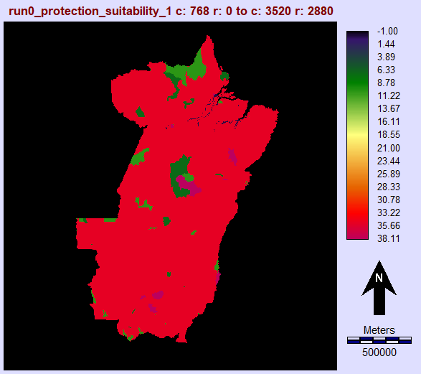
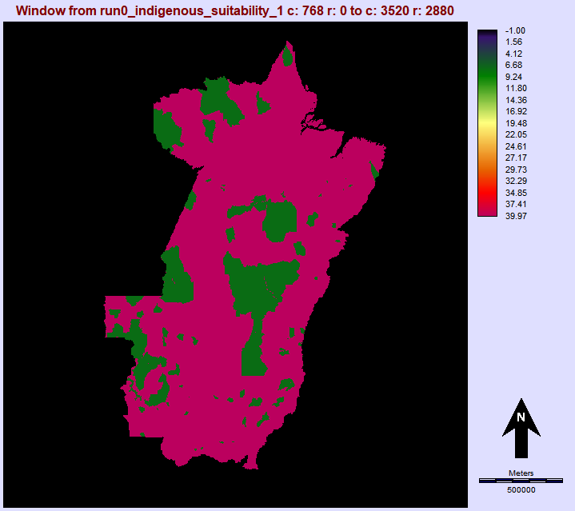
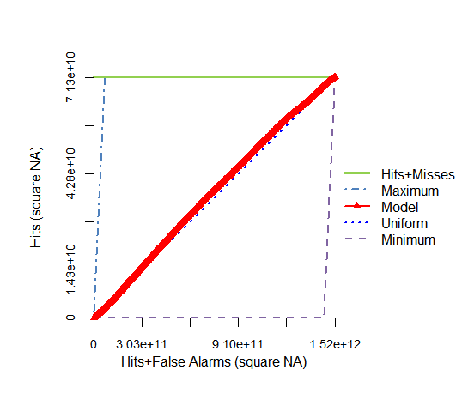
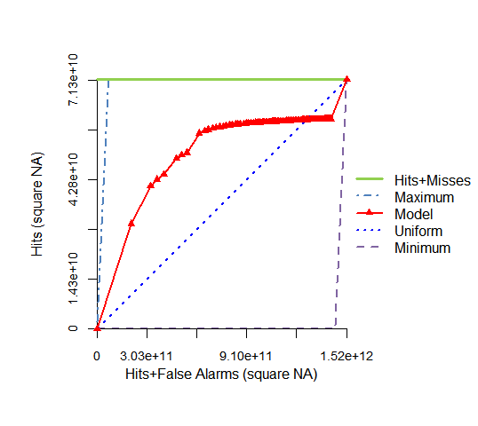
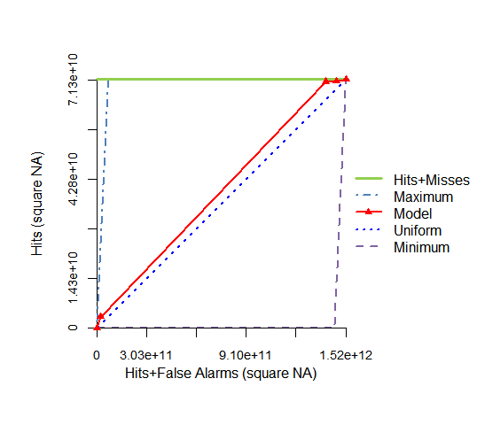
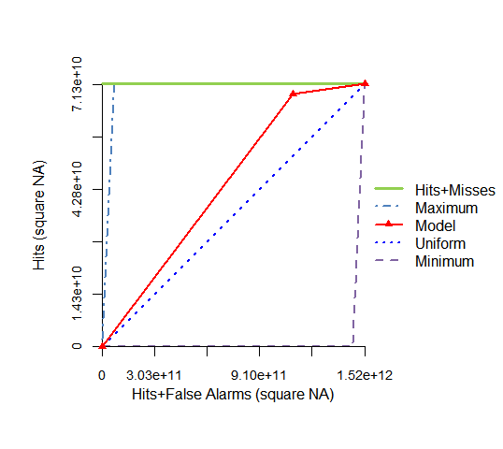
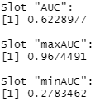
Run 0: Suitability Maps and TOC Curves of Individual Variable
Elevation
Crops and Pastures
Protection
Indegenous Distribution
TOC Curve 图
AUC Value
AUC = 0.522
AUC = 0.701
AUC = 0.553
AUC = 0.623

Slide 8
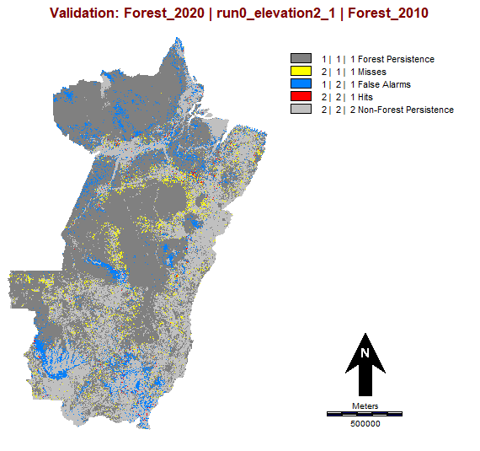
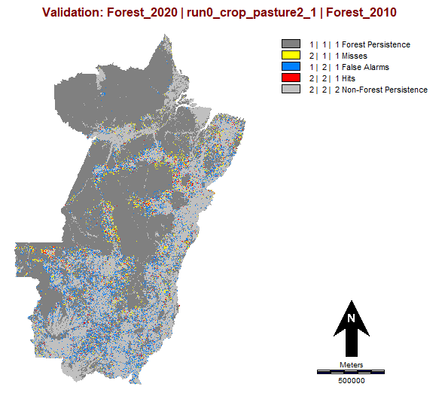
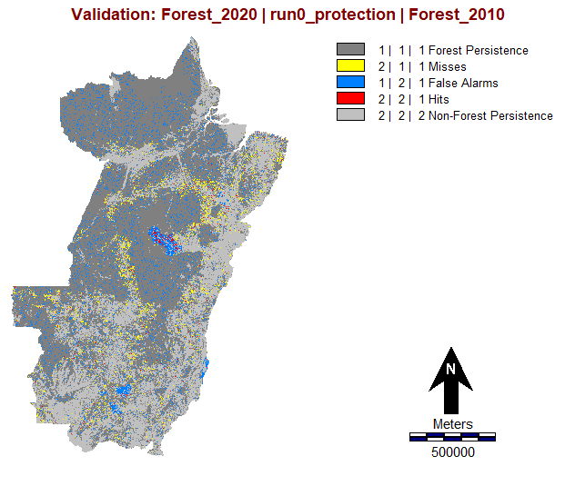
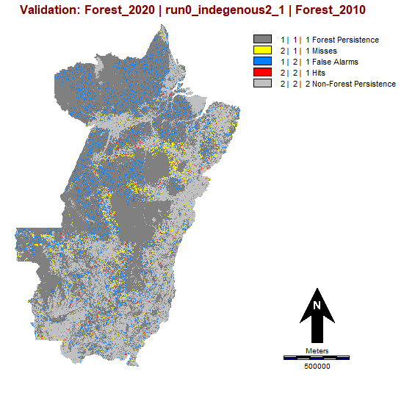
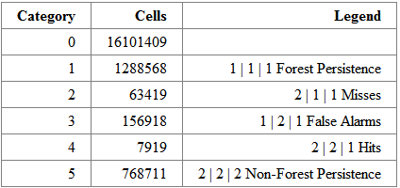
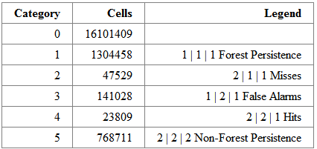
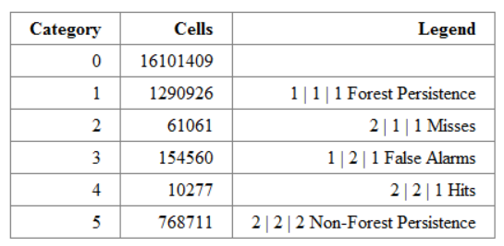
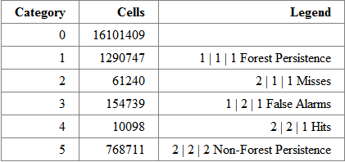
Run 0: Validation Maps for individual variable without strata image
Elevation
Crops and Pastures
Protection
Indegenous Distribution
FOM 7917/(7919+156918+63419)
= 3.70% < 9.80%
FOM =23809/(23809+141028+47529)
= 11.21% > 9.80%
FOM =10277/(10277+154560+61061)
= 4.55% < 9.80%
FOM =10098/(10098+154739+61240)
= 4.47% < 9.80%

Slide 9
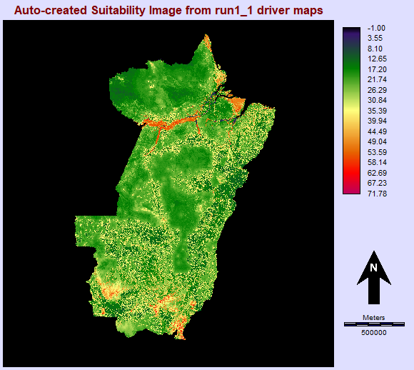
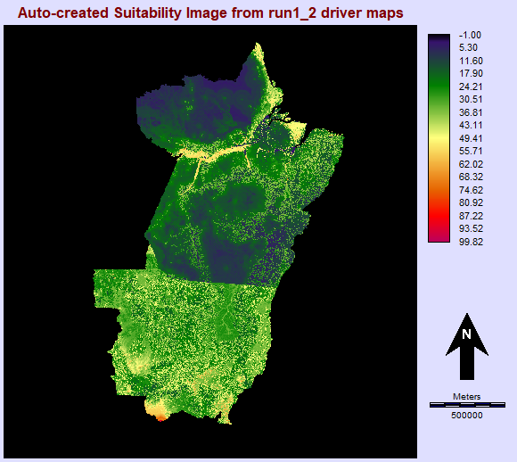
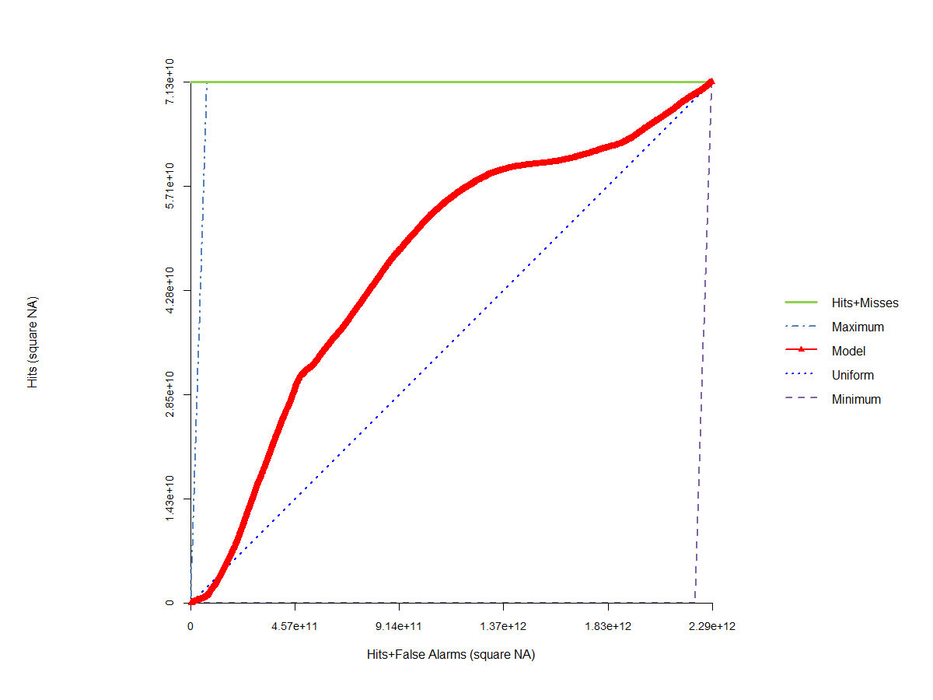
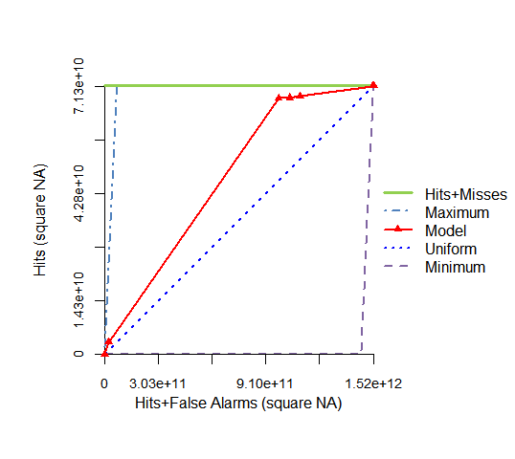
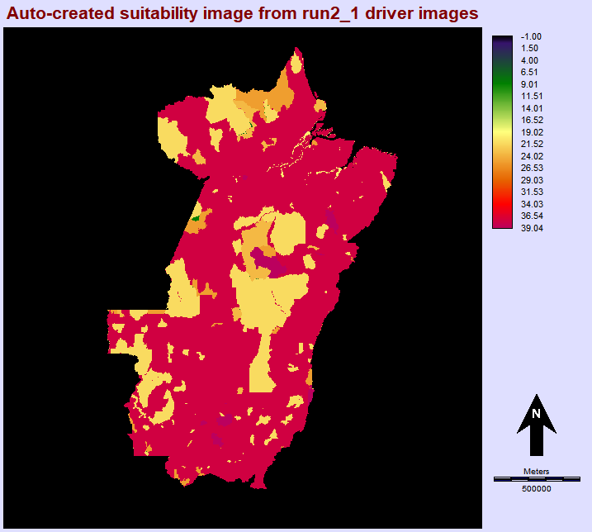
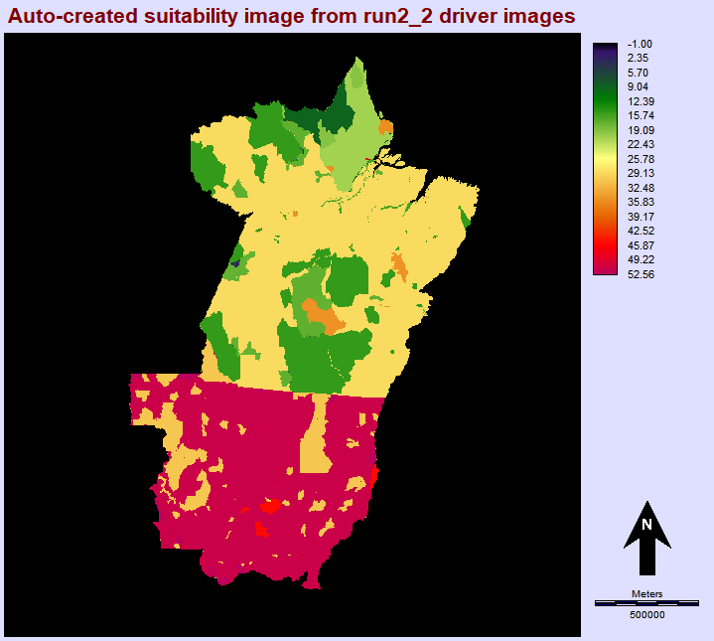
Run 1 & Run 2 Results
Suitability without strata image
Suitability with strata image
TOC Curve (Without strata image)
Run 1:
Elevation,
Crops
and
Pastures
AUC = 0.659
Run 2:
Protection, Indigenous Distribution
AUC = 0.669

Slide 10
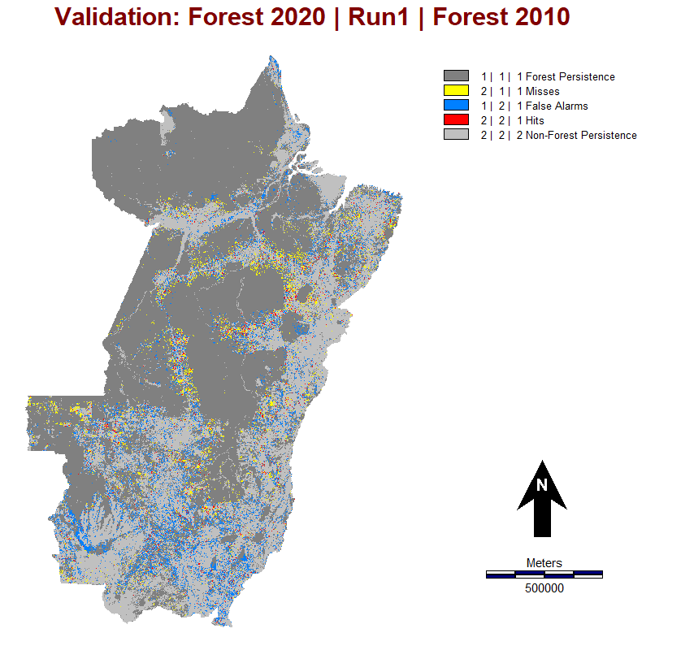
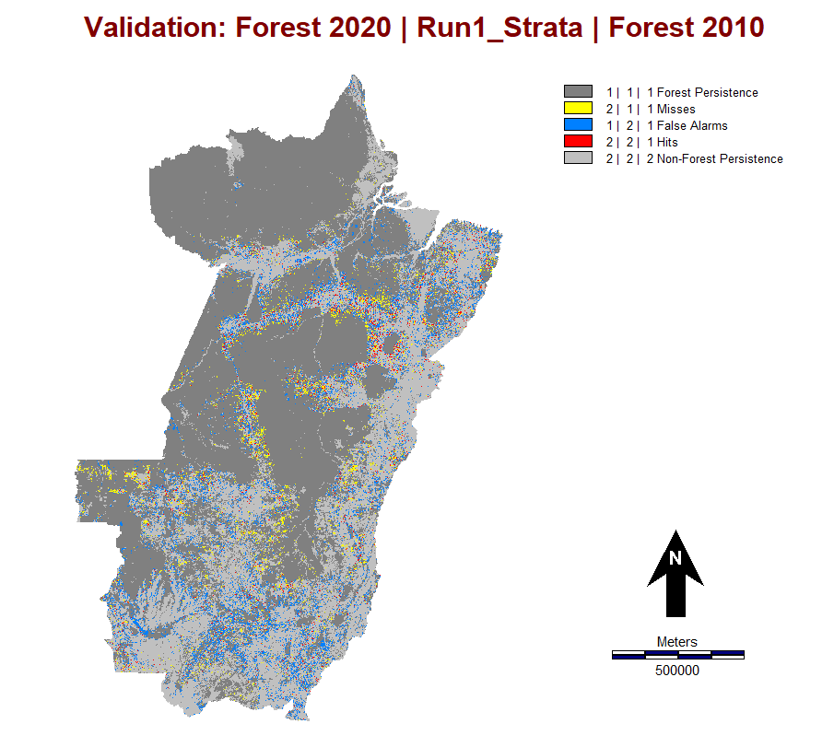
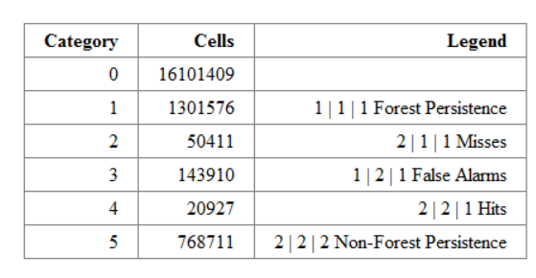
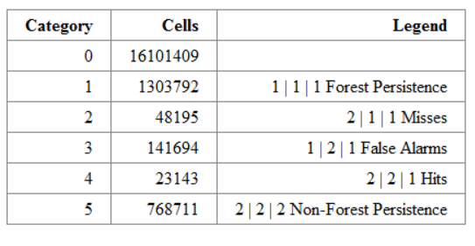
Run 1 without strata image result
Run 1 with strata image result
FOM = 20927/(50411+143910+20927)
=9.72% < 9.80%
FOM = 23143/(48195+141694+23143)
= 10.86% > 9.80%

Slide 11
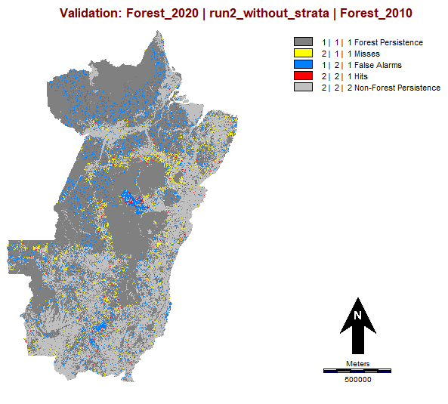
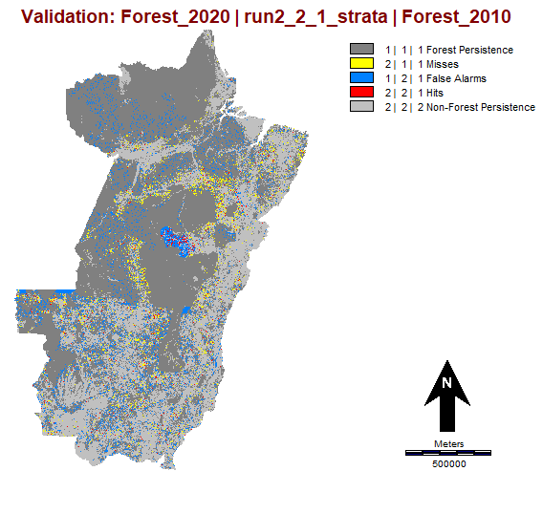
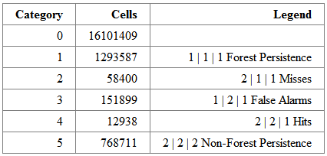
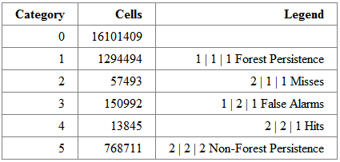
Run 2 without strata image result
Run 2 with strata image result
FOM = 12938/(12938+151899+58400)
= 5.80% < 9.80%
FOM = 13845(13845+150992+57493)
= 6.23% < 9.80%

Slide 12
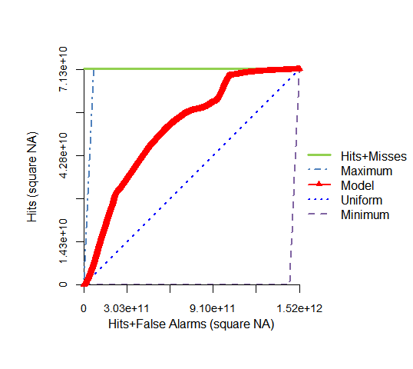
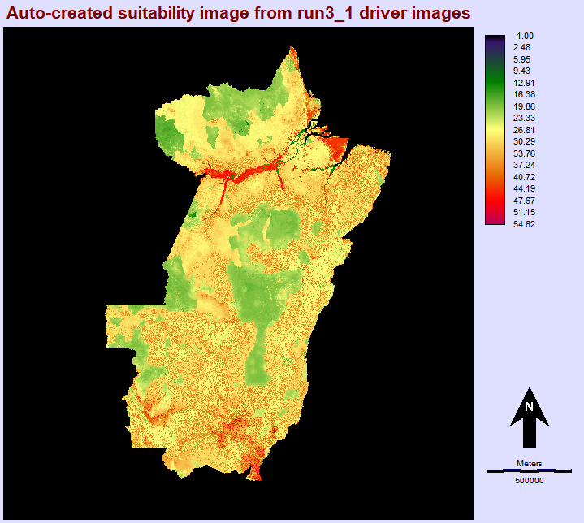
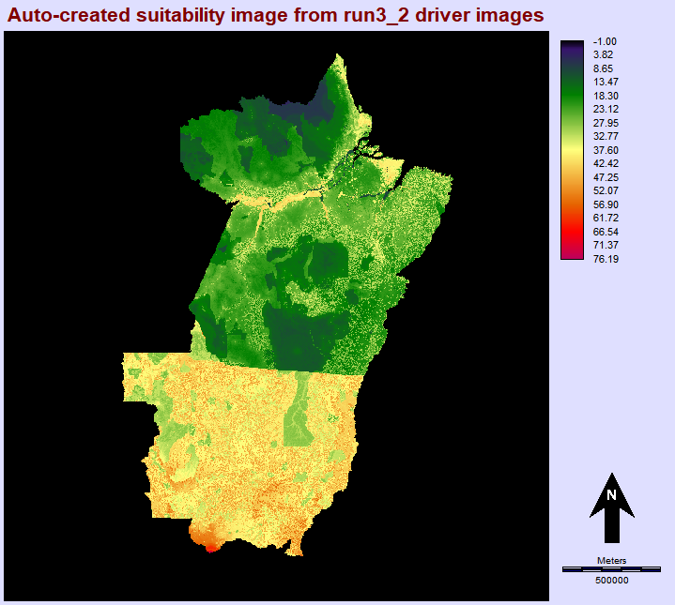
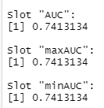
Run 3 Results
TOC Curve (Without strata image)
Suitability without strata image
Suitability with strata image
Run 3:

Slide 13




Run 3 without strata image result
Run 3 with strata image result
FOM =22049/(22039+142743+49244)
= 10.32% > 9.80%
FOM = 23820/(23820+141017+47518)
= 11.22% > 9.80%

Slide 14
Conclusion
More drivers will not necessarily produce a more accurate simulation than a single driver map.
Crop and Pasture produce larger AUC values than other factors.
Stratification increases the accuracy of the simulations.

